Slide 1
INFT4017 Research Methods
Learning Advisers
Student Engagement Unit

Slide 2
In this session
The ‘what’ and ‘why’ of referencing
why incorporate information from sources?
The ‘how’ to do
in-text referencing
a reference list
Paraphrasing strategies
Integrating the ideas of others
paraphrasing
quoting
summarising
Study Help - Referencing site
Q&A

Slide 3
What is referencing?
‘Referencing is a standard practice used in academic writing to show your reader which ideas you have gathered from other sources and where those ideas came from’ (UniSA 2016, p. 2).
This means your assignments need to show:
which ideas are not your own and
where they have come from

Slide 4
So … why reference?
To acknowledge the ideas of others. This:
shows you have read widely and been informed by expert and reliable sources
shows the range of ideas and approaches you have found and thought about
shows you have been engaged with theories and knowledge relevant to your profession
allows you to use these ideas to build on what is known e.g. topic, argument, etc.
reflects standard academic practice and values
is a characteristic of academic writing i.e. evidence based.
To show your ideas
To prevent circumstances where plagiarism can occur.

Slide 5
Two components of referencing
Harvard UniSA
In-text referencing (in the body of your essay)
………(Dyson 2008, p. 7).
Dyson (2008, p. 7) states that…….
List of references (at the end of the essay)
Dyson, JR 2008, Business organizations, Roadhouse Publishers, London.

Slide 6
1. In-text referencing - Harvard
Information first
Problem-solving negotiation is essentially a type of bargaining (Haigh 2004).
Author mentioned in reference only - emphasis on information.
Author first
Haigh (2004) describes problem-solving negotiation as a type of bargaining.
Author mentioned in body of sentence - emphasis on author.

Slide 7
Reporting verbs
When using author first in-text references, you need to choose a verb to report the information.
Misailidi and Bonoti (2008, p. 196) state that while ‘… there was some variation in performance depending on the individual emotions examined, overall participants in all age groups understood that drawings express the emotions of their creators.’
Use a range of reporting verbs when using author first referencing
Match these verbs to the way the author is expressing their idea

Slide 8
Reporting verbs
describes
proposes
reports
shows
argues
suggests
analyses
demonstrates
states
observes
believes
says
comments

Slide 9
2. Reference list format
References
Judd, D, Sitzman, K & Davi, GM 2010, A history of American nursing: trends and eras, Jones and Bartlett, London.
Sandler, MP, Patton, JA, Coleman, RE, Gottschalk, A, Wackers, FJ & Hoffere, PB 1999, Diagnostic nuclear medicine, Williams & Wilkins, Baltimore.
Whittemore, R 2009, ‘How can nursing intervention research reduce the research-practice gap?’, Canadian Journal of Nursing Research, vol. 41, no. 4, pp. 7–15.
Single line spacing required
Leave space between each entry
No indentation required

Slide 10
FAQ: one author cited in another’s work
You are reading an article by Jones and want to use this information:
‘Basically, education was seen as preparation for work’ (Kemmis et al. 1983, p.40).
Your paraphrased writing might look like this:
In addition, schools prepared students for work (Kemmis et al., cited in Jones 2009, p.38).
Adapted from: Jones, TM 2009, ‘Framing the framework: discourses in Australia’s national values education policy’, Educational Research for Policy and Practice, vol. 8, pp. 35-57.

Slide 11
FAQ: block quotations
Quotes 30+ words
indented both sides
one font size smaller.
Ellipsis (...) shows 1+ words omitted.
As Stam (2005a, p. 4) suggests:
The shift from a single-track verbal medium such as the novel to a multi-track medium like film, which can play not only with words (written and spoken) but also with music, sound effects, and moving photographic images, explains the unlikelihood and ... undesirability of literal fidelity.
It is puzzling, then, that readers and audiences are so critical of adaptations which take liberties, sometimes for the better, with their source material.

Slide 12

Questions?

Slide 13
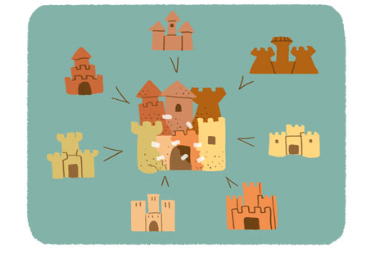
Ideas in writing
Distinguish your ideas from the author’s by:
quoting
paraphrasing
summarising
Avoid ‘cut and paste’ approaches.
Consider how you use the ideas/knowledge from
sources in your assignments.
What are lecturers and tutors looking for?
Consider the difference between ‘knowledge telling’ and
‘knowledge transforming’ (Bereiter, Burtis & Scardamalia 1988).
(University of Michigan 2014)

Slide 14
Quoting
Using a word or group of words from another source:
a quote may be words you read or heard
original source must be copied exactly
for short quotes use quotation marks (i.e., ‘...’)
must be accompanied by a citation including page number: (Mott-Smith 2011, p. 7)
Words from original source copied directly within single quotation marks
Jogulu (2010, p. 705) found ‘significant differences between leadership styles and cultural groups, hence, supporting the argument that culture and leadership interact in different ways in diverse contexts’.

Slide 15
Why should you use direct quotes?
The author expresses an idea or opinion that is:
distinctly succinct
memorable
interesting
strengthens your argument from referring to an authority

Slide 16
Activity 1 - Quoting
See activity sheet

Slide 17
Activity 1 - Quoting
Example using direct quotes:
Smith (2020) asserts that secondary school students experienced mixed realities during the Covid-19 lockdown. One year 12 student said that ‘I'm really sad and disappointed … this year should have been one of my best years of schooling,’ whereas, another year 12 student stated that ‘learning was more enjoyable … it was flexible and self-paced’ (Smith 2020, p.1).
Which words are the student’s words concerning Smith’s ideas?
Which words are quoted from Smith’s article?
What does p.1 mean and why has the student included this information?
Why did the student use direct quotes rather than paraphrase?
When is it appropriate to use direct quotes in academic writing? Why?

Slide 18
Paraphrasing
Using an idea from another source but written in your own words:
The words of the original source must not be copied
The paraphrase
comes from an oral or written source
is not enclosed in quotation marks
is accompanied by a citation

Slide 19
Activity 2 – Paraphrasing
See activity sheet

Slide 20
Activity 2 – Paraphrasing
Sentence from source (verbatim – the exact same words originally used):
‘The internet has created more opportunities to access knowledge, and has presented learners with copious ways to connect, communicate, and collaborate’ (Brown 2021, p.1).
Paraphrasing and citing the source in an essay
According to Brown (2021) the internet has increased educational prospects, and provides students with various means to interact and work together online.

Slide 21
Activity 2 – Paraphrasing
Why has the student used Brown’s ideas in the essay?
How has the student shown whose ideas are given?
How has the student shown where to find Brown’s ideas?
Identify and match the original ideas (in the verbatim text) with the paraphrased ideas (in the paraphrased text).
What changes did the student make to avoid copying Brown’s text word for word?

Slide 22
Example: Paraphrasing
Ideas from original expressed in own words. Citation included to acknowledge original source.
Original text (taken from Jones 2009, p.38):
The conservative orientation to education prevailed before the 1960s, with schools and teachers taking an authoritative approach and inculcating students with the dominant values, beliefs and practices of the time. Students are seen as passive recipients of this knowledge. Basically, education is understood as preparation for work (Kemmis et al. 1983). Conservative values education approaches vary. They can be based on religious or secular conceptions of morality, for example. However, they can be distinguished by their focus on preparing the student to fit or follow the conventions of the social, civic, religious or local community.
Paraphrase:
Education in the conservative realm took on a very authoritative approach in that values were always imposed onto students who were seen as passive beneficiaries (Jones 2006, p. 38). In addition, schools prepared students for work (Kemmis et al., cited in Jones 2006, p. 38). The context in this approach will vary depending on what the definition of morality is in a particular instance (Jones 2006, p. 38).

Slide 23
Paraphrasing strategies
Paraphrasing at the ‘meaning’ level rather than the ‘sentence’ or ‘language’ level involves finding, understanding, and rewording the ideas.
Rather than focusing on imitating what a text says or how it says it, focus on:
what it means and
why it’s important

Slide 24
One approach to paraphrasing
Read the source
Check your understanding
Put away the source
Retell aloud the main points (to another person or record )
Write them down (2-3 sentences)
Re-read source to ensure you’ve accurately represented the main ideas
Put away the source
Check your writing for meaning and flow
Check against the source & make necessary changes
Share your paraphrase with your partner

Slide 25
Activity 3 – Paraphrasing
See activity sheet

Slide 26
Activity 3 – Paraphrasing
Source
‘Over the last twenty years, technology has reorganised how we live, how we communicate and how we learn. Learning theories that describe learning principles and processes should be reflective of underlying social environments’ (Siemens 2005, p.1).
Read the source
Check your understanding
Put away the source
Retell aloud the main points (to another person)
Write them down
Re-read source to ensure you have accurately represented main ideas
Put away the source
Check your writing for meaning and flow
Check against the source & make necessary changes
Notes:
Siemens, G 2005, Connectivism: A learning theory for the Digital Age. International Journal of Instructional Technology and Distance Learning, viewed 22 March 2021, <http://www.itdl.org/>

Slide 27
Paraphrase #1
The dissatisfying nature of industrial or clerical work is no longer disputed. Many of today’s employees prefer a greater level of involvement in their jobs than was previously assumed. Many desire more self-control and a chance to make a greater contribution to the organisation.
(Schuler, Dowling & Smart 1988, p. 17).
It is no longer disputed that the nature of industrial and clerical work is dissatisfying. Employees prefer more involvement in their jobs, desire more self-control and a chance to make a bigger contribution to their organisation (Schuler, Dowling & Smart 1988, p. 17).
Plagiarised: superficial changes

Slide 28
Paraphrase #1
The dissatisfying nature of industrial or clerical work is no longer disputed. Many of today’s employees prefer a greater level of involvement in their jobs than was previously assumed. Many desire more self-control and a chance to make a greater contribution to the organisation.
(Schuler, Dowling & Smart 1988, p. 17).
It is no longer disputed that the nature of industrial and clerical work is dissatisfying. Employees prefer more involvement in their jobs, desire more self-control and a chance to make a bigger contribution to their organisation (Schuler, Dowling & Smart 1988, p. 17).
Plagiarised: superficial changes

Slide 29
Paraphrase #2
The dissatisfying nature of industrial or clerical work is no longer disputed. Many of today’s employees prefer a greater level of involvement in their jobs than was previously assumed. Many desire more self-control and a chance to make a greater contribution to the organisation (Schuler, Dowling & Smart 1988, p. 17).
According to Schuler, Dowling and Smart (1988, p. 17), employers are at fault for requiring their staff to perform menial tasks that fail to develop their skills and denying them opportunities for having a say in how the organisation is run.
Inaccurate paraphrasing

Slide 30
Paraphrase #3
The dissatisfying nature of industrial or clerical work is no longer disputed. Many of today’s employees prefer a greater level of involvement in their jobs than was previously assumed. Many desire more self-control and a chance to make a greater contribution to the organisation
(Schuler, Dowling & Smart 1988, p. 17).
People working in factory and office environments want to be given more responsibility by being allowed some freedom in self managing their work, as well as having more input in their business’s operations
(Schuler, Dowling & Smart 1988, p. 17).
Plagiarised: no in-text referencing

Slide 31
Whose voice?
Studies examining children’s understanding of the emotions expressed in drawings have yielded conflicting results in relation to when this ability develops. The variability in the results may be due to differences in the task demands of different studies. First, in Carothers and Gardner’s (1979) as well as in Winner et al.’s (1986) study, abstract drawings were used as stimuli. It is possible that abstract stimuli may lead to an underestimation of young children’s true understanding, since it has been documented that children prefer realist to abstract art (Child, 1971; Child & Iwao, 1973; Gardner & Winner, 1976; Ramsey, 1982, 1989; Winner, 1982). Second, in Callaghan’s (2000) study a forced-choice task was used requiring children to associate the picture of one artist to one of two drawings. In such a forced-choice task, young children may have perceived the designated emotion in the selected picture or merely a different emotion in the non-selected picture. Using only two pictures, therefore, may result in an overestimation of children’s competence.
Adapted from: Misailidi, P, & Bonoti, F 2008, ‘Emotion in children's art: do young children understand the emotions expressed in other children's drawings?’, Journal of Early Childhood Research, vol. 6, no. 2, pp.189-200.

Slide 32
Whose voice?
Studies examining children’s understanding of the emotions expressed in drawings have yielded conflicting results in relation to when this ability develops. The variability in the results may be due to differences in the task demands of different studies. First, in Carothers and Gardner’s (1979) as well as in Winner et al.’s (1986) study, abstract drawings were used as stimuli. It is possible that abstract stimuli may lead to an underestimation of young children’s true understanding, since it has been documented that children prefer realist to abstract art (Child, 1971; Child & Iwao, 1973; Gardner & Winner, 1976; Ramsey, 1982, 1989; Winner, 1982). Second, in Callaghan’s (2000) study a forced-choice task was used requiring children to associate the picture of one artist to one of two drawings. In such a forced-choice task, young children may have perceived the designated emotion in the selected picture or merely a different emotion in the non-selected picture. Using only two pictures, therefore, may result in an overestimation of children’s competence.
Adapted from: Misailidi, P, & Bonoti, F 2008, ‘Emotion in children's art: do young children understand the emotions expressed in other children's drawings?’, Journal of Early Childhood Research, vol. 6, no. 2, pp.189-200.

Slide 33
Summarising
Condensing the main ideas of a text in your own words
Putting the main ideas into your own words
Only the main points and no details (examples) are included
Provides a broad overview and usually shorter than the original
Cites the original source

Slide 34
Example: Summarising
If key scenes from a novel are pruned for film, audiences often react negatively. However, fidelity is not an appropriate measure for evaluating a film adaptation’s success, as numerous scholars concur (Desmond & Hawkes 2006; Leitch 2008; McFarlane 1996; Miller & Stam 2004).
Writer has consulted different sources on the topic and has summarised the main theme that has been discussed by different researchers.

Slide 35
Activity 4 – Summarising
See activity sheet

Slide 36
Activity 4 – Summarising
Discussion activity (small group)
Pretend you are all academic authorities in the field of student procrastination.
Discuss the causes or the emotions associated with student procrastination.
Note down 2-3 points that you all agree on, then summarise your ideas (in 2-3 sentences).
Allocate someone to write down your summary (2-3 sentences).
Reference your summary using all your surnames and 2021 for the date.
Report back to the whole group.

Slide 37
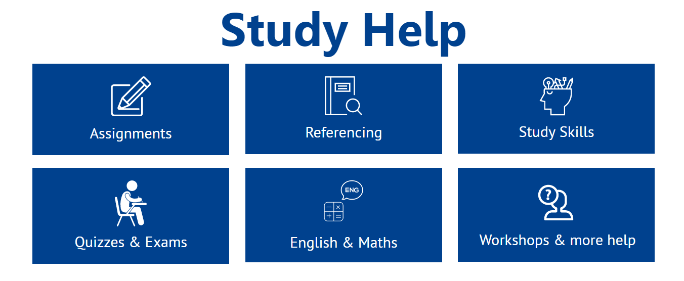
Learning support at UniSA
Learning Advisers provide resources and advice on areas such as:
Assignment tasks e.g. annotated bibliographies, literature reviews
Academic writing
Referencing and academic integrity

Slide 38
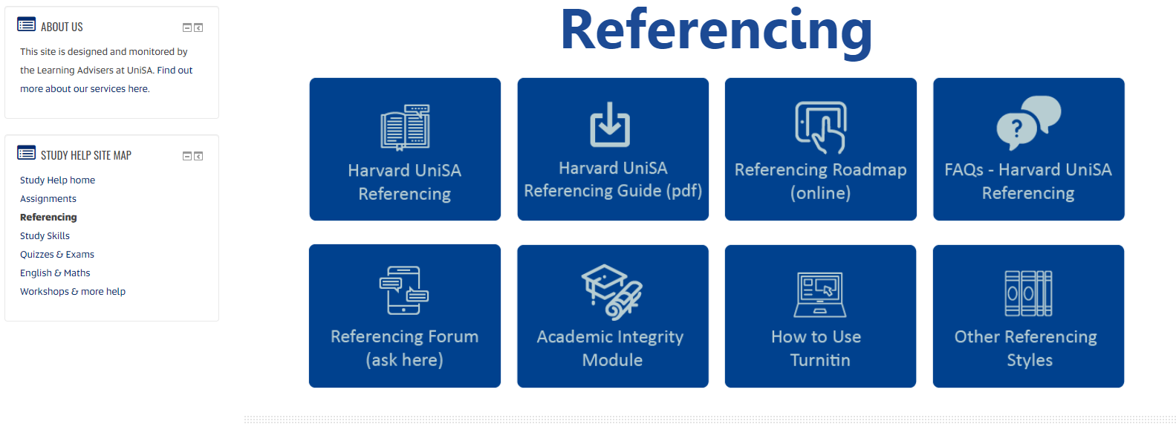
Referencing information
Paraphrasing resources (UniSA Study Help)
How to paraphrase using Harvard UniSA
What is paraphrasing?

Slide 39
Questions?

